Slide 1

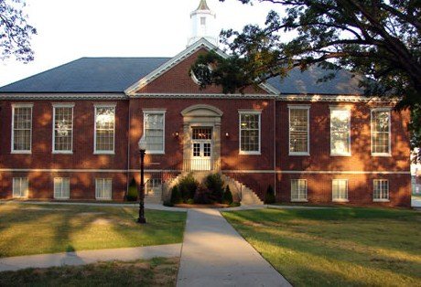
An Evening Reference Librarian turns library instruction on its head: Bennett College and the Holgate library improving information literacy through assessment in a flipped instructional model in Jenzabar e-Racer course management system (CMS).
HBCU Alliance Leadership Institute IV
Project Report

Slide 2
PRESENTATION OUTLINE
Abstract
Project Goals
Structure
Process
Overall Outcomes
Key Innovations

Slide 3
ABSTRACT
As the mission, programs and services of academic libraries evolve so must the way we interact with library users. The use of content management systems (CMS) is key to improving curriculum focused content and library assessment to reach users in this platform. The presentation will investigate the Thomas F. Holgate’s 1st interaction with its CMS platform. There will be an overview of what learning objects were integrated through Web 2.0 applications (e.g. Snag-it) and screen video capture (i.e. Camtasia) in an effort to provide a flipped instructional model for the History Departments - HL 101 Section 1 &2 classes. This project will aid in improving the library’s instructional course model for information literacy for history students by integrating learning outcome measurement tools through a Pathfinder Tutorial that provides formative and summative quizzes to assess the successfulness of the research tutorials and library instruction. This presentation will outline specific practices implemented in the BellNet - CMS platform.

Slide 4
PROJECT GOALS
Collaborate with faculty to review course syllabus to embed Information Literacy (IL)language and content
Measure the users understanding IL through a series of module based tutorials
Decrease instructional time through a Flipped Instructional Model

Slide 5
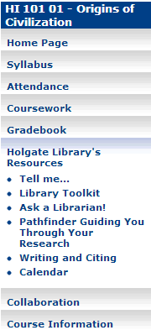
STRUCTURE
Stakeholders
  Prof. Jennifer Ash, History Dept.
  William Morris, IT Dept.
  Joan Williams, Library Director
Jenzabar
  e-Racer Course Management System(CMS)
Flipped Instructional Model
  Holgate Library’s Resources
    Tell Me
    Library Tool Kit
    Ask a Librarian!
    Pathfinder Guiding You Through Your Research
      6 Modules
      5 Workbooks
    Writing and Citing
      APA and MLA Handouts
  Collaboration
    Poll Everywhere

Slide 6
PROCESS
Pros & Cons
  Stakeholders
  Technology
  Faculty/Staff

Slide 7
OVERALL OUTCOMES
“Students First”
Improved awareness of what IL is and what tools are being used to push that initiative
Loads of Data
  What can work?
  Asynchronous tutorials
Did it make a difference?
  Students
  Faculty

Slide 8
KEY INNOVATIONS
  Students were engaged in a Flipped Instructional Model vs. a traditional in-person instructional sessions?
    The introduction of the Pathfinder into this Flipped Instructional Model provided me the perfect opportunity to be heard but not seen.
    An average of 85% of all work assigned and completed by students via the CMS was done asynchronously.

Slide 9
KEY INNOVATIONS
Did the library meet the faculty members information literacy needs?
  Camtasia allowed me to create curriculum focused content to push library resources
  Using Poll Everywhere to start a conversation via virtual chat.
Notes:
Innovation - something new or different introduced

Slide 10
SUMMARY
The project yielded great results! Faculty got a chance to see what new tools were being used in the library to improve our information literacy initiative and the students were engaged in a new form of instruction (i.e. Flipped Instructional Model) that improved their research strategy efforts.

